Slide 1
Ggplot2 and interactive graphics with R
Christophe Ladroue
SECTION 05
VIDEO 02
Ordering factors
www.PacktPub.com

Slide 2
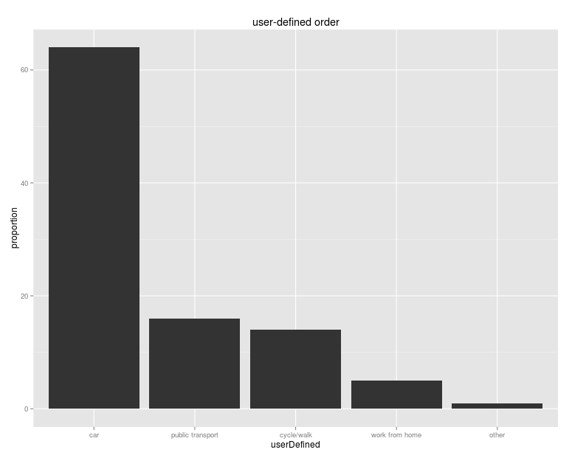
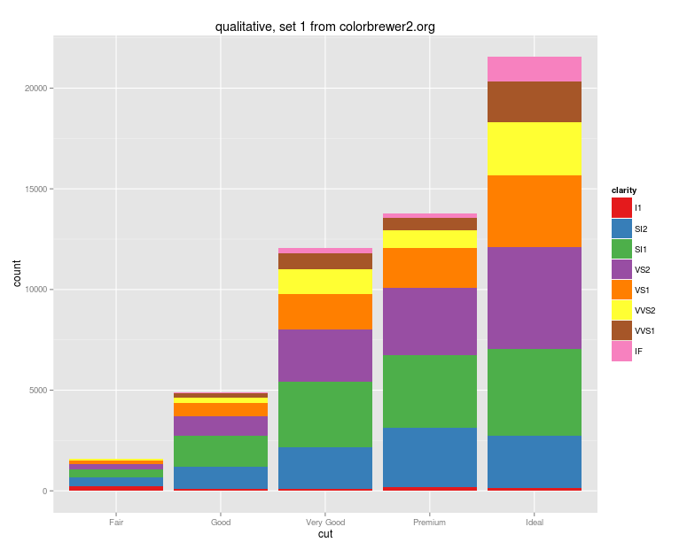
In this video we took a look at
how categorical variables are ordered on a graph by default.
how to re-order the factors to suit a user-defined sequence.
how to re-order the factors programmatically.
Next: colors for categorical variables

